Slide 1


Docker, Kafka, and Argo Workflows in Action: Event-Driven Workflow for .NET Applications
Lyubomir Ganchev | Senior developer

Slide 2

Agenda
Kafka
Docker
Argo workflows
Backend dev roadmap
DEMO Overview diagram
DEMO
Notes:
Elements (version 2)
Elements are used to give more detail to a set of ideas, they should all relate to the same topic.
Use this page for a list of deliverables, key roles on a project, phases of a project, or any topic that can be broken down into more specific examples.
Each section should have an icon that relates to the content of that specific element, no icon should be repeated on the same page, and they should all be the same colour.
Keep the text to 1-2 sentences and aim to have about the same amount of content under each element.

Slide 3
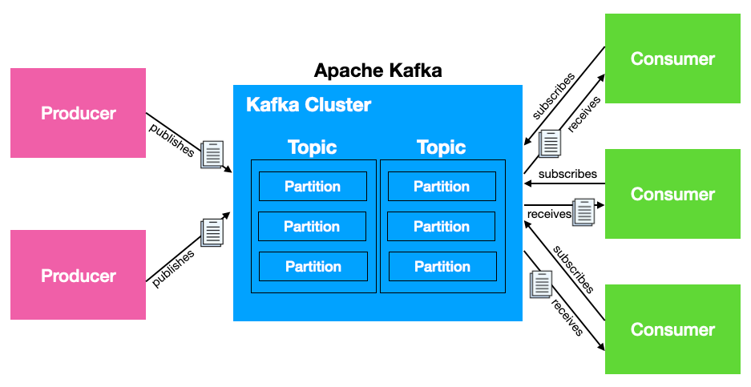
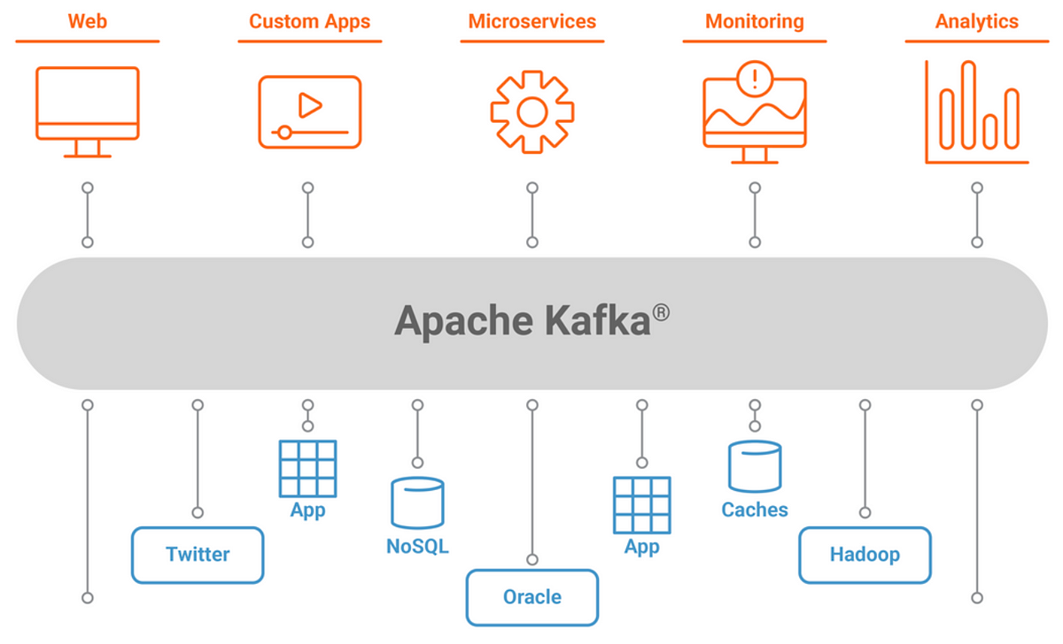
Kafka
Event streaming platform
Producers and consumers
Kafka topics
Various integrations
Notes:
Elements (version 4)
Elements are used to give more detail to a set of ideas, they should all relate to the same topic.
Use this page for a list of deliverables, key roles on a project, phases of a project, or any topic that can be broken down into more specific examples.
Each section should have an icon that relates to the content of that specific element, no icon should be repeated on the same page, and they should all be the same colour.
Use this version when there are less examples to breakdown with more text associated with the element.

Slide 4
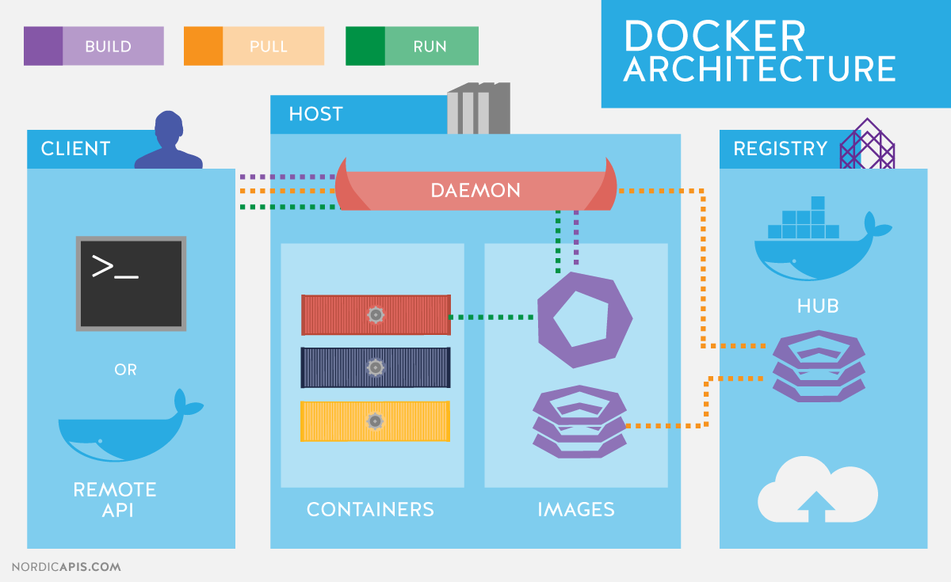
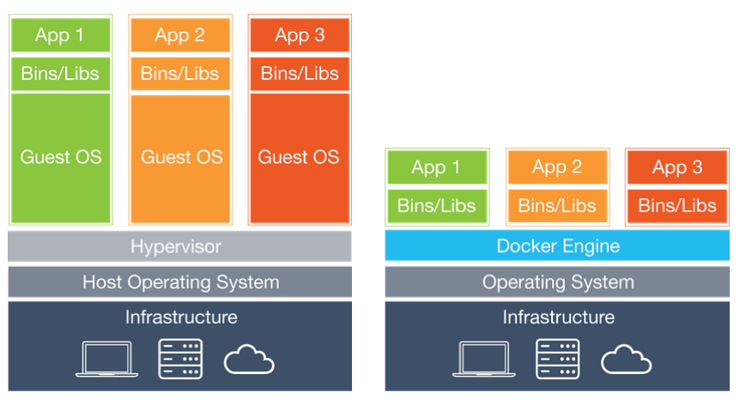
Docker
open-source containerization platform
Containerization vs Virtualization
Docker images
Docker hub
Notes:
Elements (version 4)
Elements are used to give more detail to a set of ideas, they should all relate to the same topic.
Use this page for a list of deliverables, key roles on a project, phases of a project, or any topic that can be broken down into more specific examples.
Each section should have an icon that relates to the content of that specific element, no icon should be repeated on the same page, and they should all be the same colour.
Use this version when there are less examples to breakdown with more text associated with the element.

Slide 5
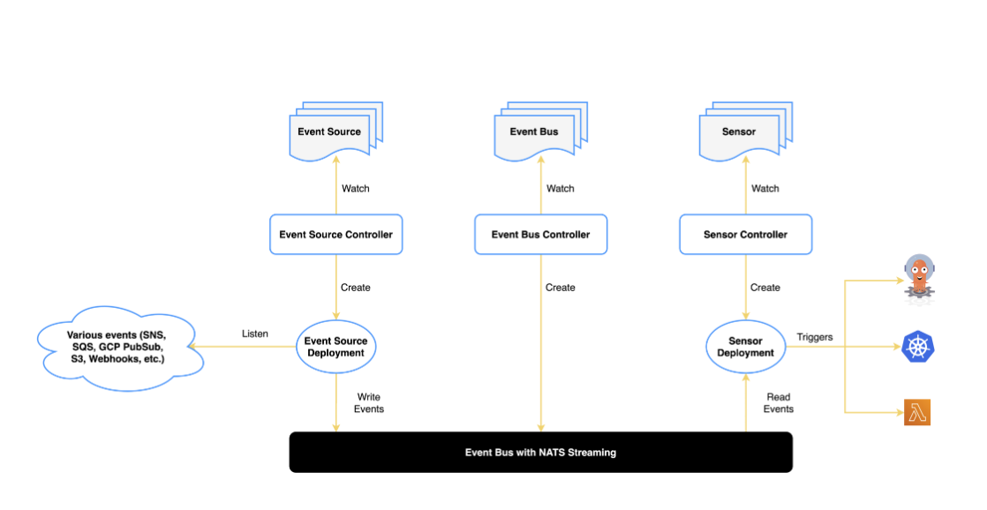
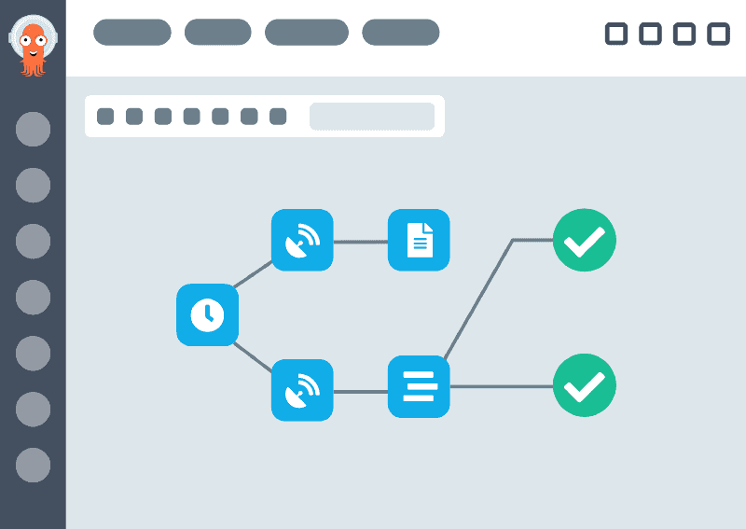
Argo Workflows
Workflow execution engine and templating
Argo events – eventbus, Eventsource, sensor, Trigger
ARGO WORKflows GUI
Running in k8s cluster
Notes:
Elements (version 4)
Elements are used to give more detail to a set of ideas, they should all relate to the same topic.
Use this page for a list of deliverables, key roles on a project, phases of a project, or any topic that can be broken down into more specific examples.
Each section should have an icon that relates to the content of that specific element, no icon should be repeated on the same page, and they should all be the same colour.
Use this version when there are less examples to breakdown with more text associated with the element.

Slide 6
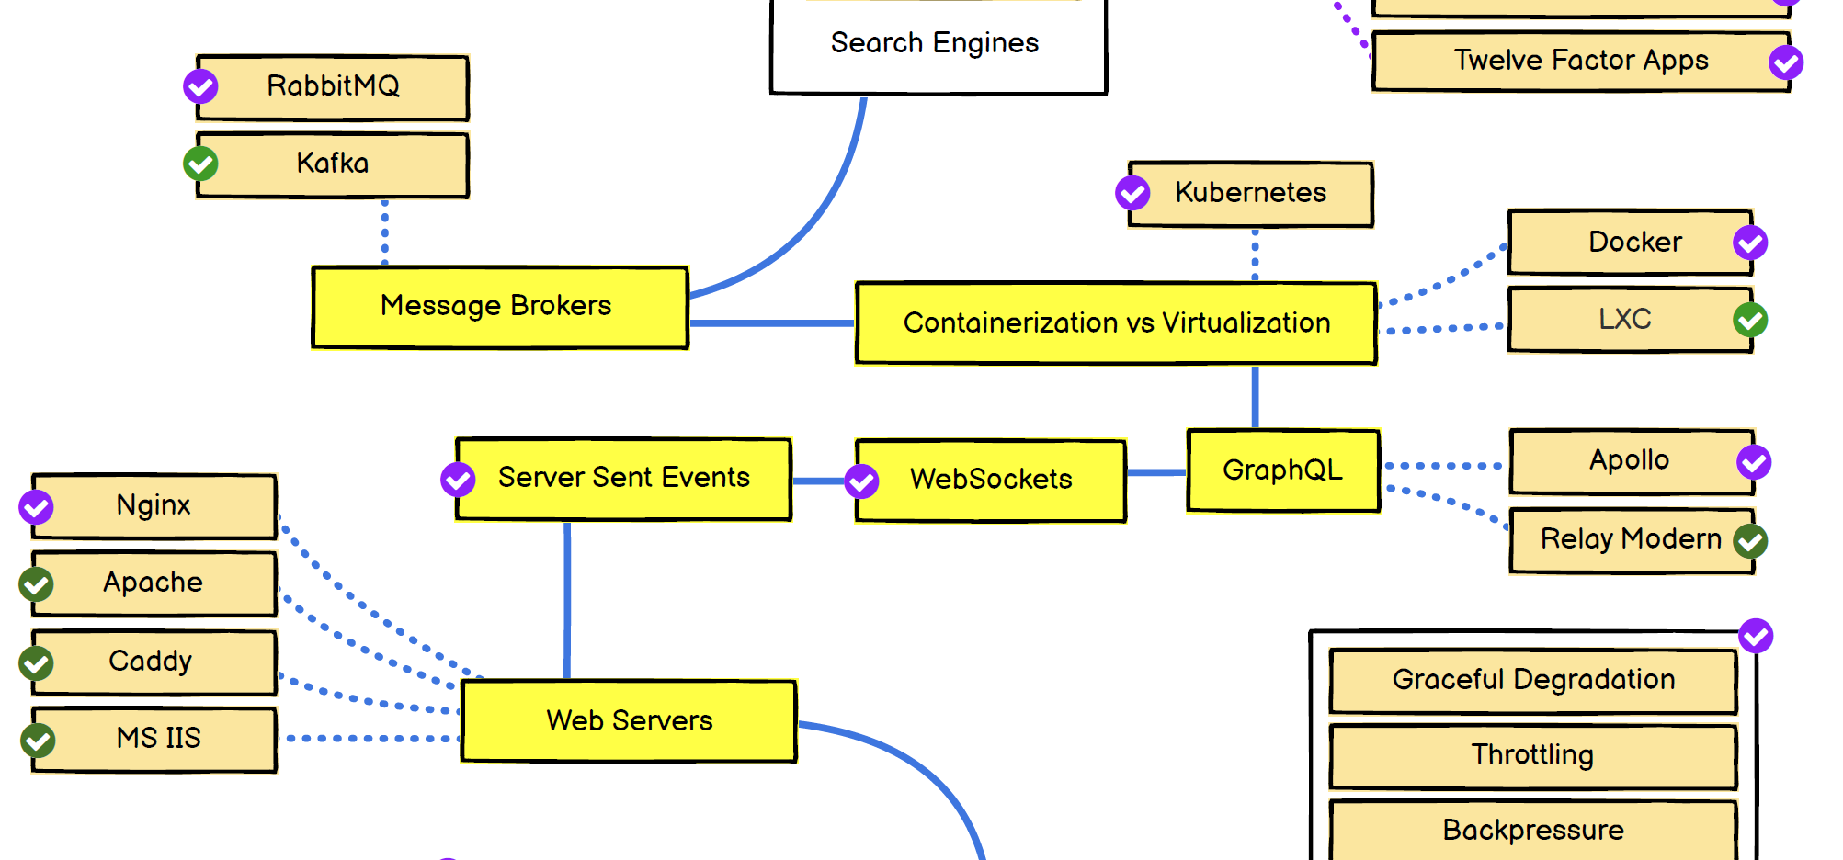
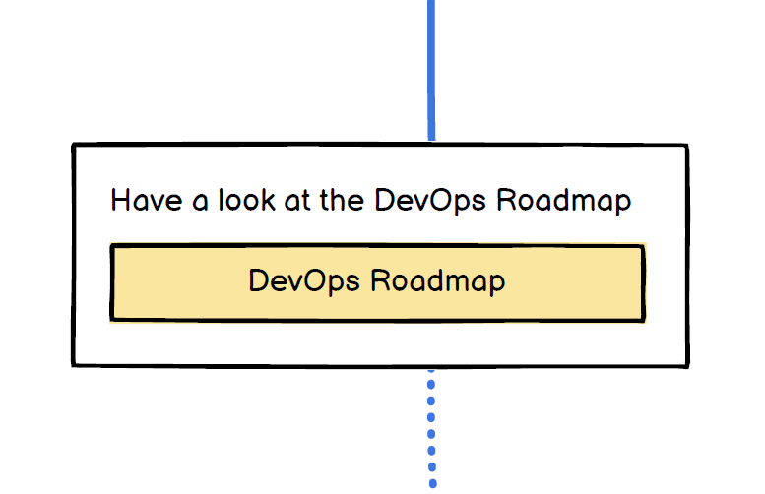
Backend Dev Roadmap
Self-confidence and knowledge improvements - https://roadmap.sh/backend
Speaking the same language with the DevOps team
Understanding and configuring app deployment
Improve debugging process
The big picture
Notes:
Elements (version 4)
Elements are used to give more detail to a set of ideas, they should all relate to the same topic.
Use this page for a list of deliverables, key roles on a project, phases of a project, or any topic that can be broken down into more specific examples.
Each section should have an icon that relates to the content of that specific element, no icon should be repeated on the same page, and they should all be the same colour.
Use this version when there are less examples to breakdown with more text associated with the element.

Slide 7
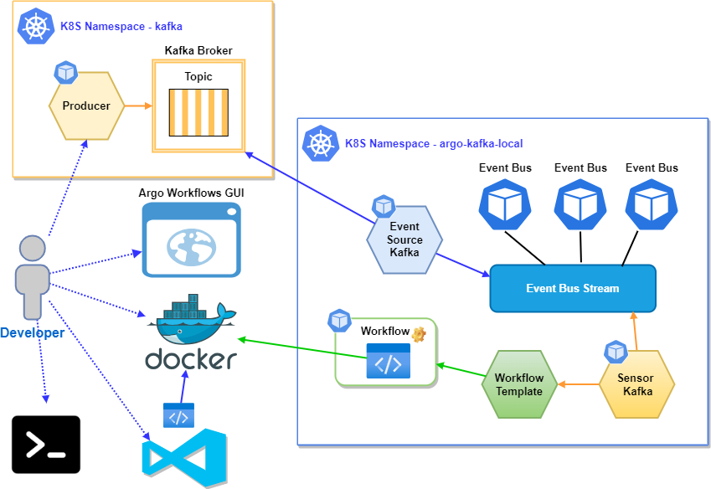
Demo Overview Diagram
Notes:
Elements (version 4)
Elements are used to give more detail to a set of ideas, they should all relate to the same topic.
Use this page for a list of deliverables, key roles on a project, phases of a project, or any topic that can be broken down into more specific examples.
Each section should have an icon that relates to the content of that specific element, no icon should be repeated on the same page, and they should all be the same colour.
Use this version when there are less examples to breakdown with more text associated with the element.

Slide 8

DEMO

Slide 9
Q&A
Thank You!

